Slide 1
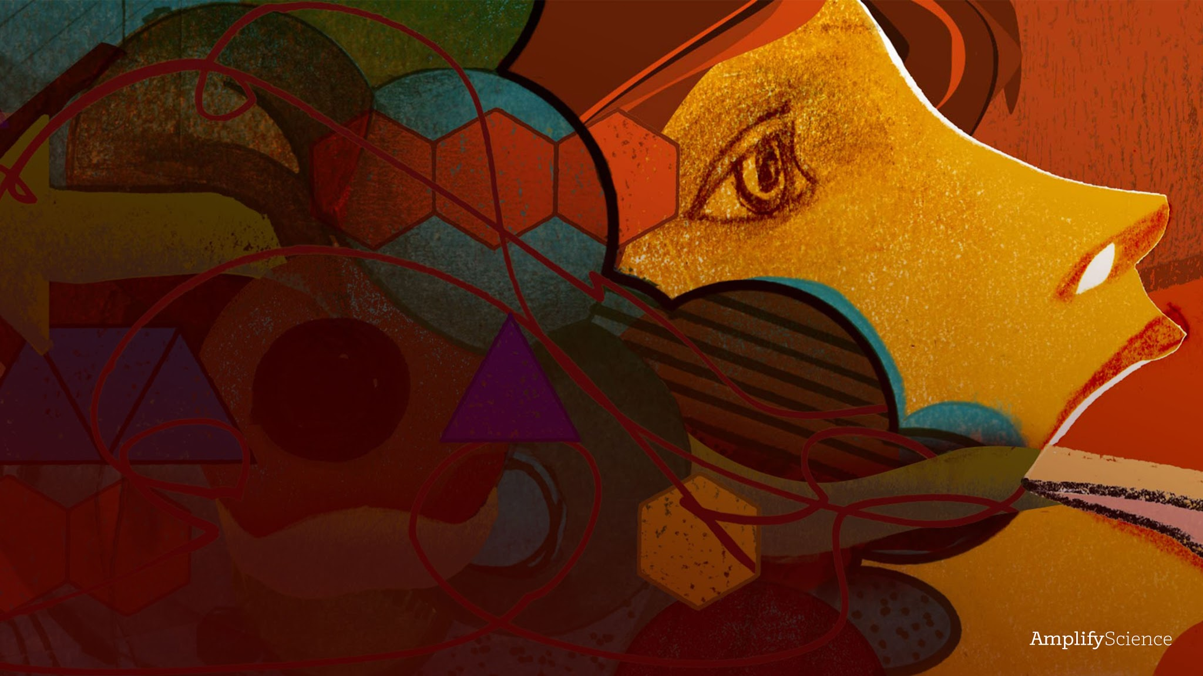
Metabolism
Lesson 1.2: Welcome to Medical School

Slide 2
Warm-Up
Today, we will begin a new unit called Metabolism.
We will start with a Warm-Up each day to get us thinking about science ideas. For today’s Warm-Up, you will watch and respond to a video that introduces your new role as medical students.

Slide 3


Slide 4
Making Predictions
Why do you think your new patient, Elisa, is feeling tired all the time?
Explain your ideas.
You have a lot of good ideas. I think we can group these into several “umbrella” claims that we can try to investigate further. I will write them on the board.

Slide 5
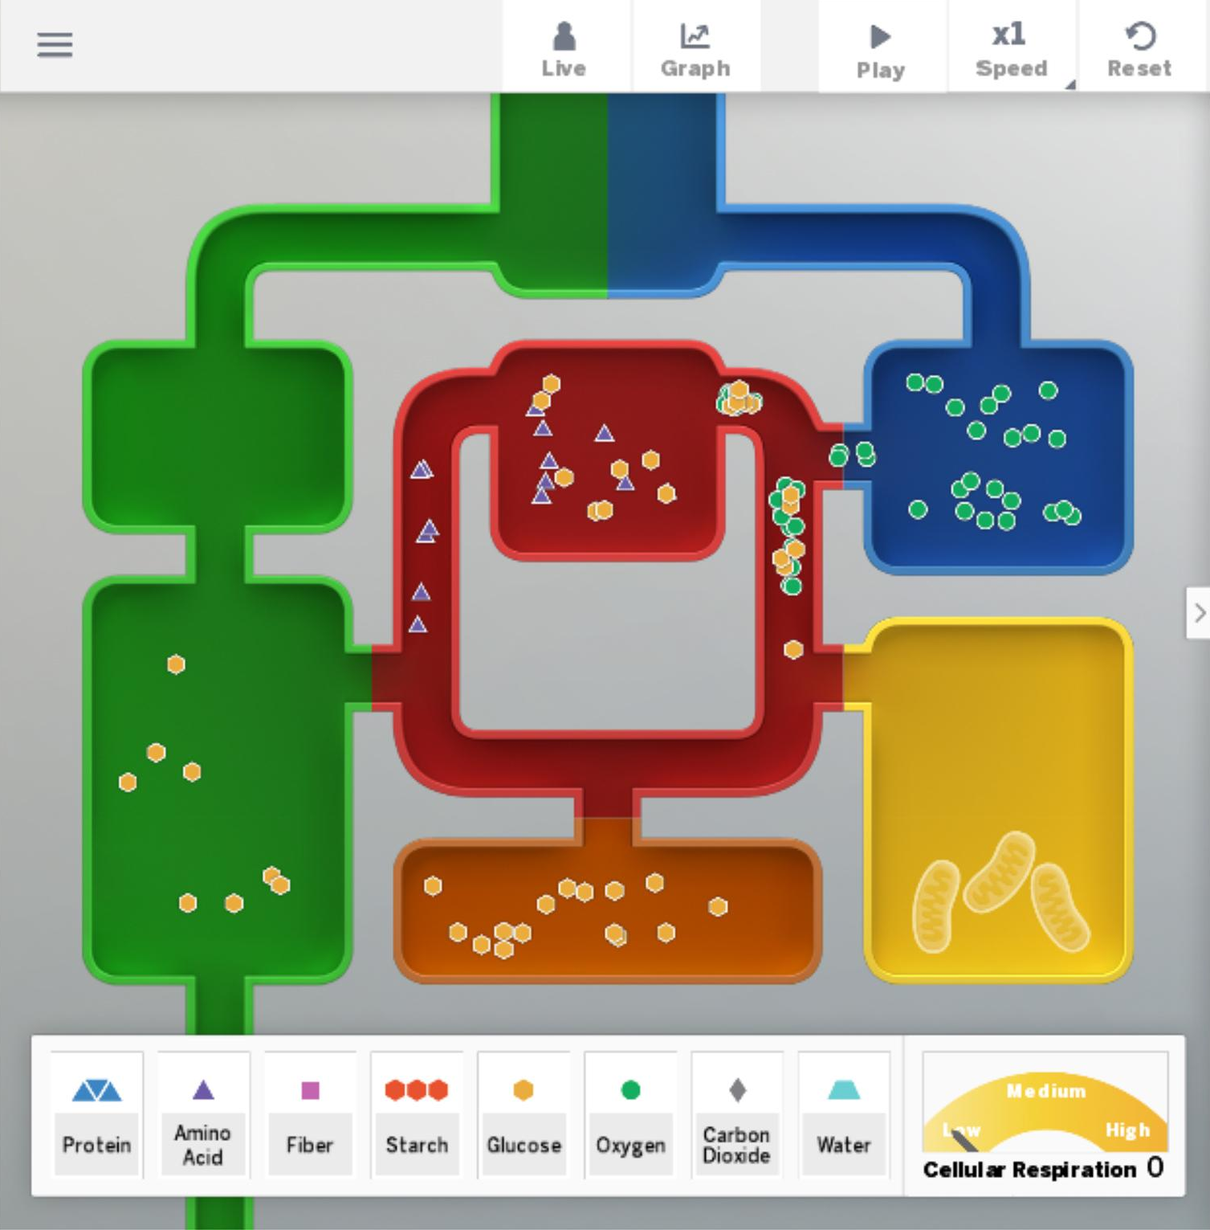
Introducing the Metabolism Simulation
A lot of things that happen in the human body are hidden or too small to directly observe. We will use a simulation to help us learn more about how human body systems function.
This simulation is called the Metabolism Simulation. It’s a scientific model of the human body that simulates many things that happen inside the human body.

Slide 6
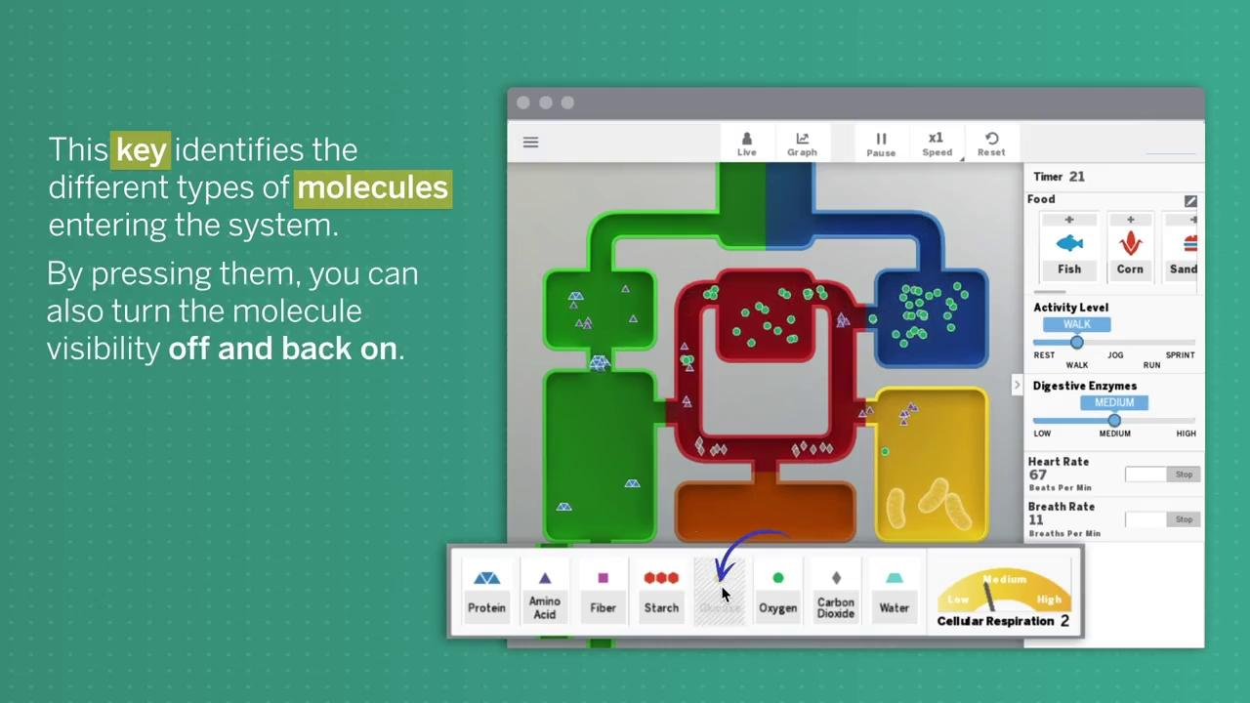

Slide 7
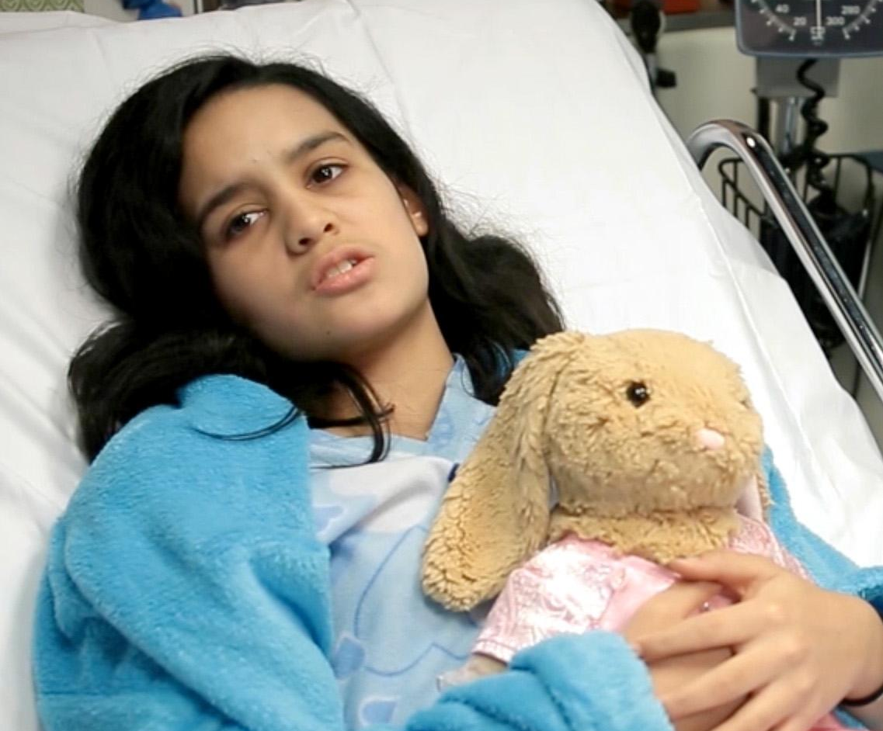
Elisa
To figure out why Elisa feels so tired, we will first think about healthy bodies.
What are some things you know the human body needs to function?
What are signs you can observe when a human body is functioning properly?

Slide 8
As we discussed, there are certain things we already know the human body needs to function. Two important things the human body needs to survive are food and air.
As you explore the Metabolism Sim again, watch what happens to the food and air that enter this healthy Simulation body.

Slide 9
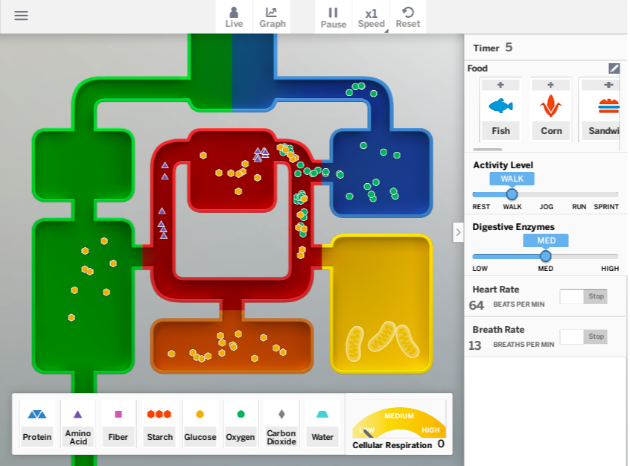
Metabolism SIM
Observe the Sim a second time.
This time, watch what happens to the food and air that enter this healthy Simulation body.
What happens to the food and air that enter this healthy Simulation body?

Slide 10
Unit Question
How do the trillions of cells in the human body get what they need to function, and what do the cells do with the things they absorb?

Slide 11
Ch 1 Question
Why does Elisa feel tired all the time?

Slide 12
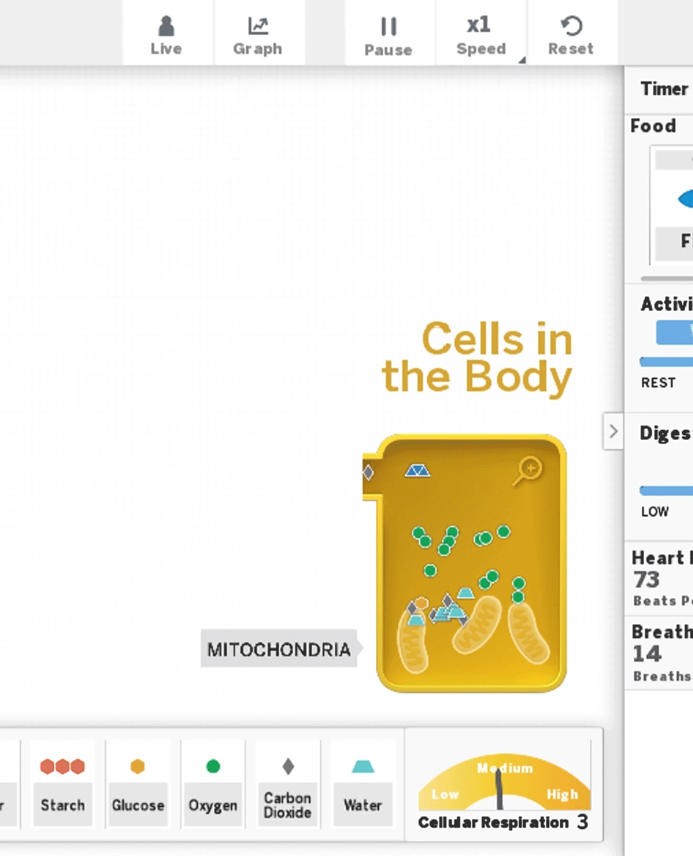
The yellow box represents one cell in this model of the healthy human body. You can zoom into this cell by pressing on the cell and then on the magnifying glass.
The trillions of cells in the body have some similarities in the ways they function, so we can learn more about what all cells need by observing one cell in the Simulation.

Slide 13

Metabolism SIM
Observe the Sim again.
This time, pay attention to what’s happening in the representative cell to learn more about what cells in the body need.
Which molecules are entering the cell?
The Metabolism Sim
can help us investigate if Elisa’s problem is related to the molecules she is taking in from the environment and/or what is happening in the cells in her body.

Slide 14
metabolism
the body’s use of molecules for energy and growth

Slide 15
Returning to the Patient
Claims
Elisa is feeling tired because she:
In the Sim, you observed that in a functioning, healthy body, certain molecules that come from food and air are transported into the body’s cells.
Remember the claims we generated about why Elisa is feeling tired.
Do you have any new insights or changes in thinking about these claims after observing the Sim?

Slide 16
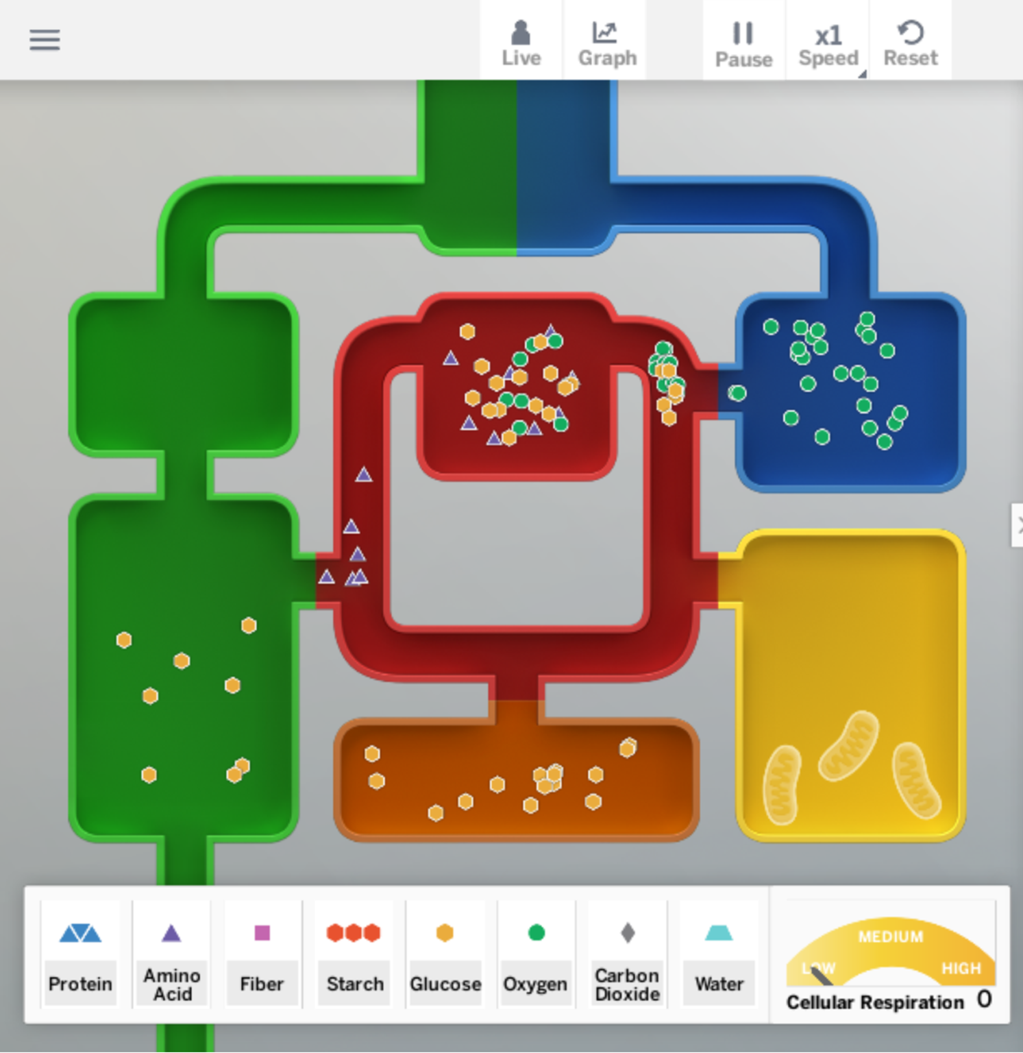
Homework pg 8
For this activity, you will experiment with different diets in the Sim to see how the diet affects the number of molecules getting to the cells. Then, you’ll record your results.

Slide 17
